Slide 1
Pairwise Ranking Tool
Submitted By: Supervised by:
Mrinmoy Poit Toukir Ahammed
Roll: 1524 Lecturer
IIT,University of Dhaka

Slide 2
Mid-Term Feedback
Implementation of Bradly-Terry Model
Work with file I/O

Slide 3
Features
7 ranking algorithms at one place
Dynamic Rating Update
Provide an optimized ranking list
User can use previous data

Slide 4
Project Description
1. A software tool to compare in pairs and rank items
2. Accurate ranking system based on comparisons
3. Provide a systematic way to make decisions

Slide 5
Algorithms Used in this project
1. Win rate calculation
2. Elo rating algorithms
3. Bradley- terry method
4. Trueskill and Glicko
5. PageRank and Bayesian

Slide 6
User Interface
The User will be asked it he/she want to use any previous data
Topic name and User name will be asked

Slide 7
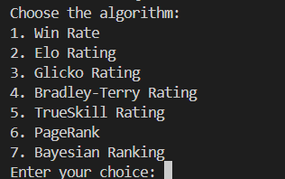
User Interface
User can choose the algorithm

Slide 8
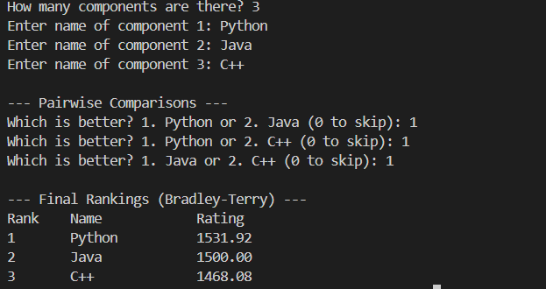
User Interface
After the comparison, rank will be provided

Slide 9
Challenges
1. Understanding the algorithms
2. Implementation of algorithms in C language
3. Handling files
4. Debugging Errors

Slide 10
My Github Repository
https://github.com/mrinmoypoit/SPL-1

Slide 11
Thank You!!!

